Slide 2
Azure Networking Pre-day
AI-CI-TS336
Jon Ormond, Jared Ross, Daniel Gicklhorn, and Amit Srivastava

Slide 3
Morning Session learning objectives
Business Problems:
Contoso has two on-premise branch offices that need to connect to their Azure deployments.
Site 1 has a NetFoundry appliance (vWAN partner appliance)
Site 2 has a Cisco CSR router (not a vWAN partner appliance)
Contoso also has remote employees at home and is planning for an ExpressRoute circuit
At the end of this session, you should be better able to…
discuss Azure Virtual WAN, when to use and why
talk about the hub and spoke model in vWAN
describe the partner device onboarding experience
describe the manual tunnel process
awareness of the P2S process
awareness of ExpressRoute connections
Notes:
Audience questions:
Who is here for Global Reach? (can anyone tell me what Global Reach is?)
Who is here for Front Door? (can anyone tell me what Front Door is?)
Who is here for both? You’re my people! ☺
Anything we should put in the parking lot to cover if time allows?

Slide 4
Azure PowerShell SDK Update

Slide 5
New Azure PowerShell SDK - Az
New Azure PowerShell SDK Module - Az
Not compatible with AzureRM (ie can’t be installed side by side)
There is an alias set, so AzureRM commands will still work
It’s not required now, but new features are going into Az only
New Azure Login Method
Connect-AzAccount
Do this in an admin PowerShell console session to give permanent access for a machine
AzureRM commands should work with Enable-AzureRmAlias
https://azure.microsoft.com/blog/how-to-migrate-from-azurerm-to-az-in-azure-powershell/

Slide 6
Idempotent PowerShell Operations
# 3.3 Create Public IPs
Write-Host (Get-Date)' - ' -NoNewline
Write-Host “Creating Public IP address“ -ForegroundColor Cyan
Try {$pip = Get-AzPublicIpAddress -ResourceGroupName $ResourceGroup `
-Name $VMNameASH'-pip' -ErrorAction Stop
Write-Host "resource exists, skipping“
}
Catch {$pip = New-AzPublicIpAddress -ResourceGroupName $ResourceGroup `
-Location $EastRegion `
-AllocationMethod Dynamic `
-Name $VMNameASH'-pip’
}

Slide 7
Building the Environment

Slide 8
Final Environment

Slide 9
Step 0
Execution:
Connect to WiFi
Browse to https://portal.azure.com
Get user name and password in KeyVault
Using those creds, RDP to VM01 in VPN Site 1
On VM01, open PowerShell run Connect-AzAccount
Login using @microsoft.com
Run
Get-AzResourceGroup –Name “CompanyXX”
to validate PowerShell and your access
(You may need to Set-AzContext to
"Virtual Data Center Workshop“)
NOTE: VM01 should be the server from
which all PowerShell and any
validation should be performed.

Slide 10
Step 1
Execution:
Open WorkshopStep1.ps1 in PowerShell ISE
(at C:\vdcWorkshop\Scripts)
Run WorkshopStep1.ps1

Slide 11
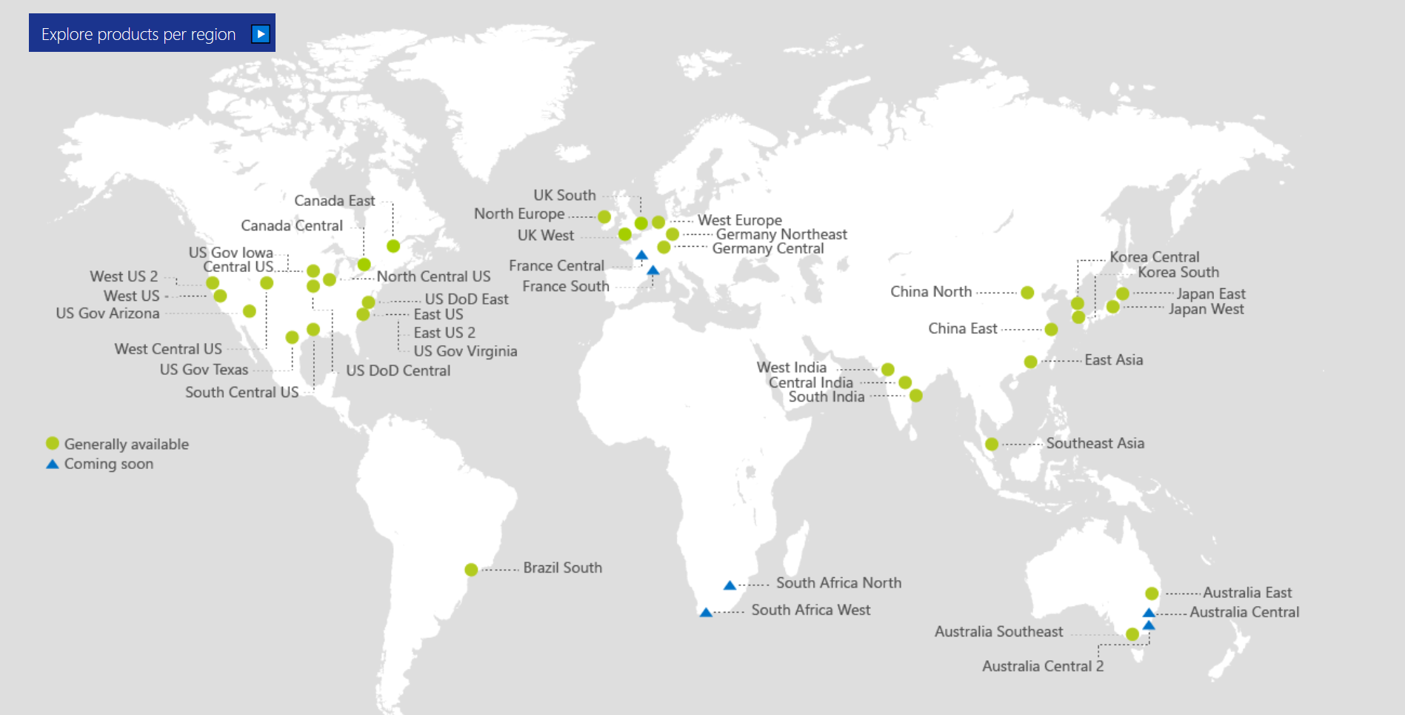
Also Announced:
Germany North
Germany West Central
Switzerland North
Switzerland West
Norway East
Norway West
UAE Central
UAE North

Slide 12
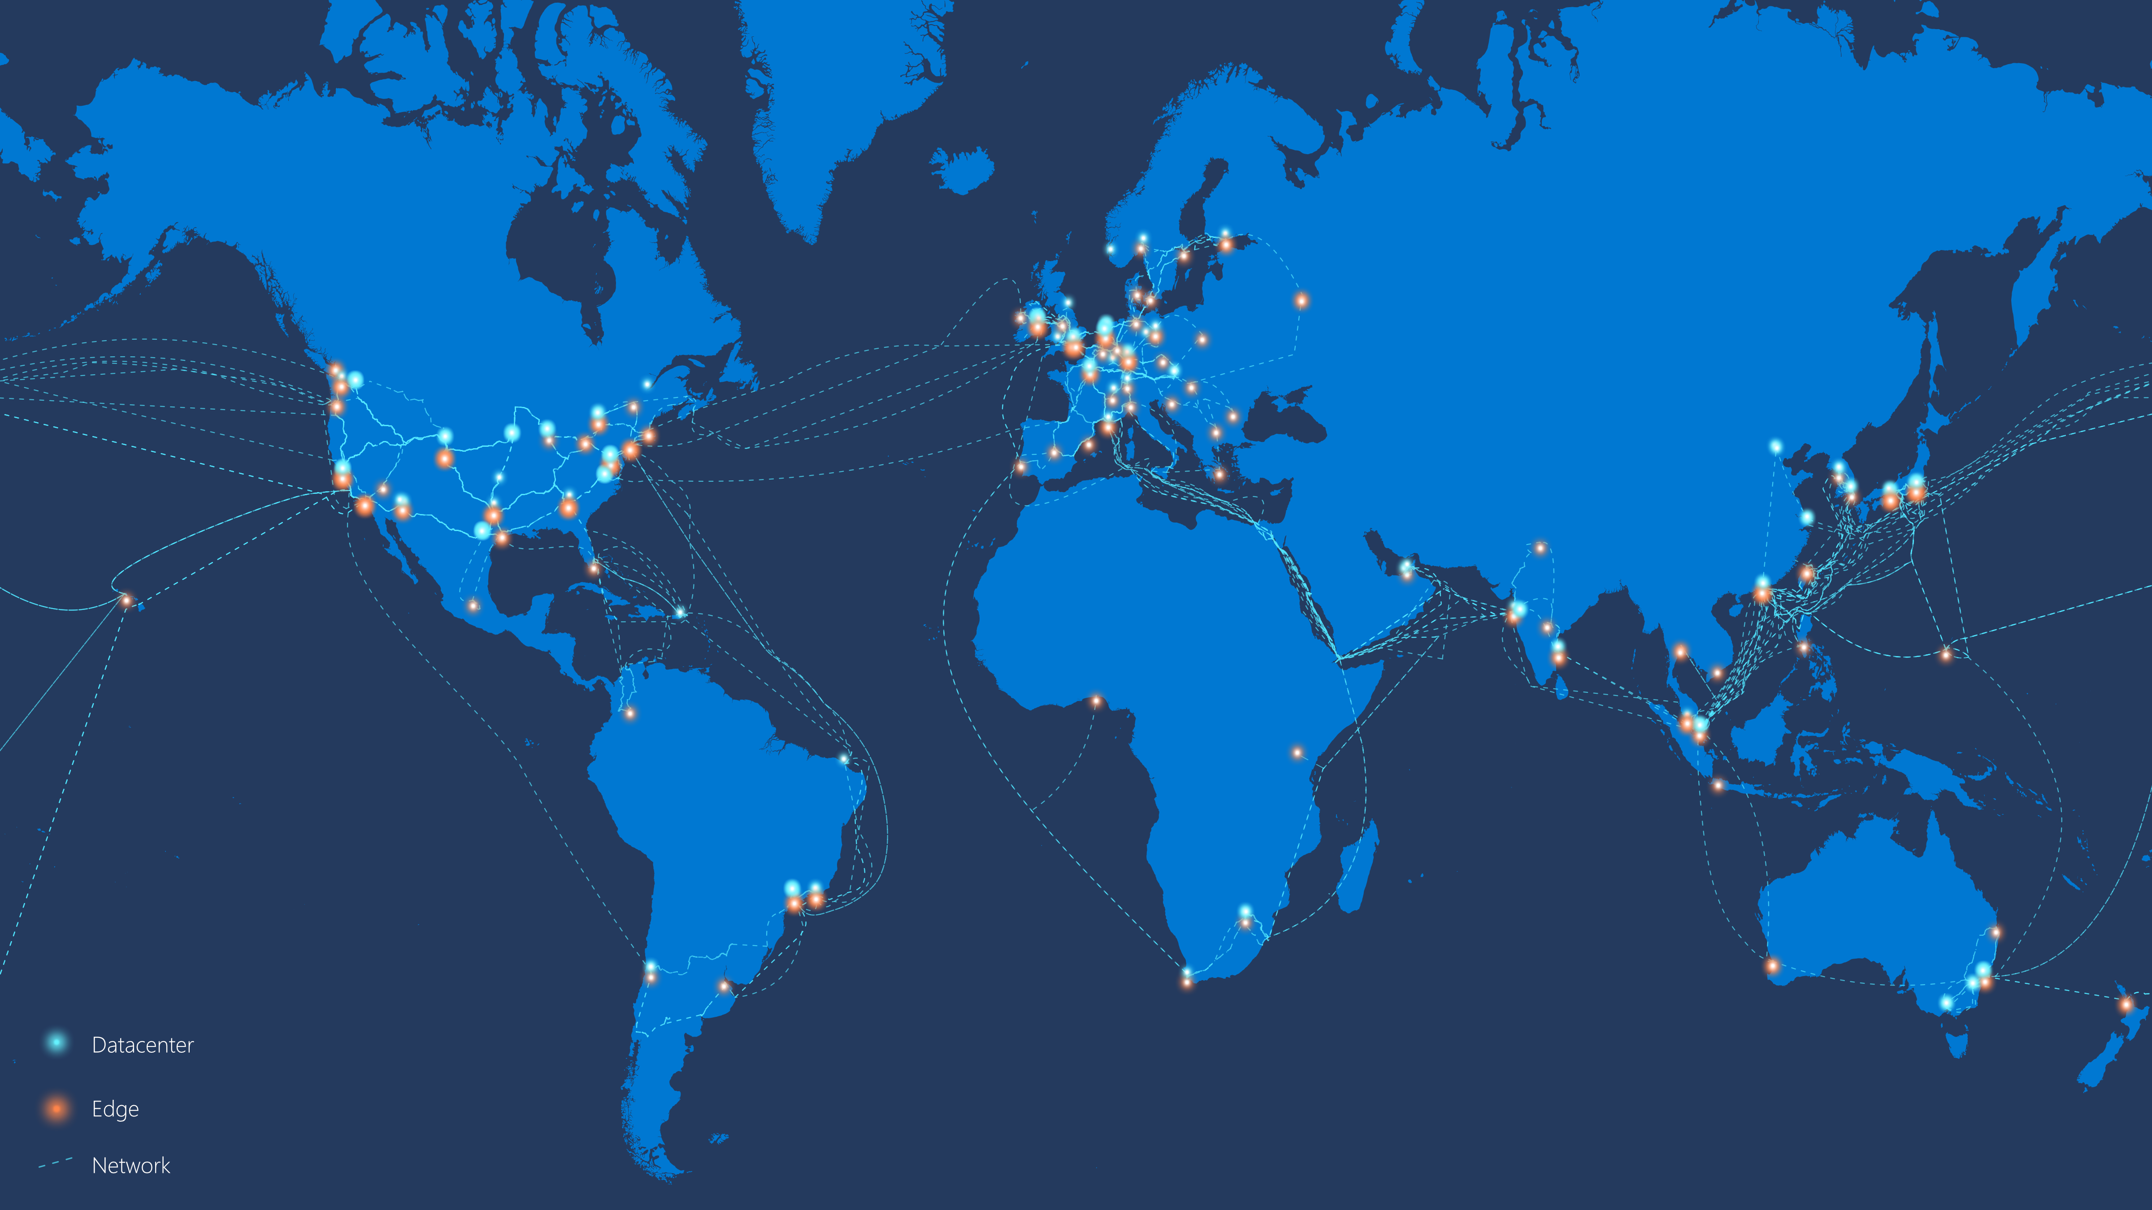
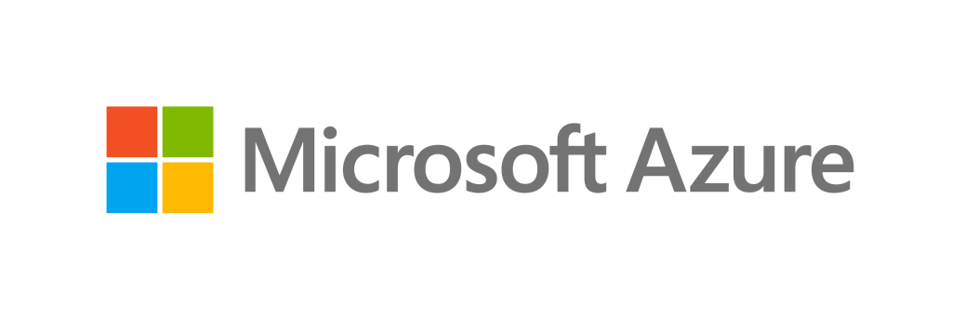
Microsoft Global Network
54
AZURE REGIONS
100K+
148
EDGE SITES
200+
EXPRESSROUTE PARTNERs
MILES OF FIBER AND SUBSEA CABLES

Slide 13
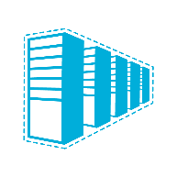

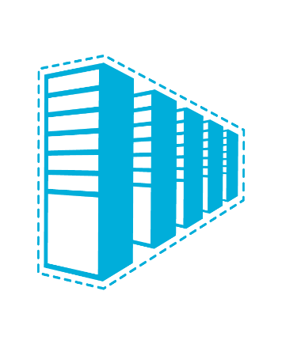


Connectivity options and hybrid offerings
Azure
Customer
Segment and workloads
Consumers
Access over public IP
DNS resolution
Connect from anywhere
Internet connectivity
Developers
POC Efforts
Small scale deployments
Connect from anywhere
Secure point-to-site VPN connectivity
SMB & Enterprises
Connect to Azure compute
Connect branch to branch
Virtual WAN and Site-to-site
VPN connectivity
SMB & Enterprises
Mission critical workloads
Backup/DR, media, HPC
Connect to all Azure services
ExpressRoute private connectivity

Slide 14
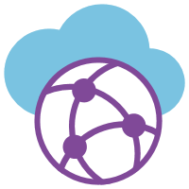
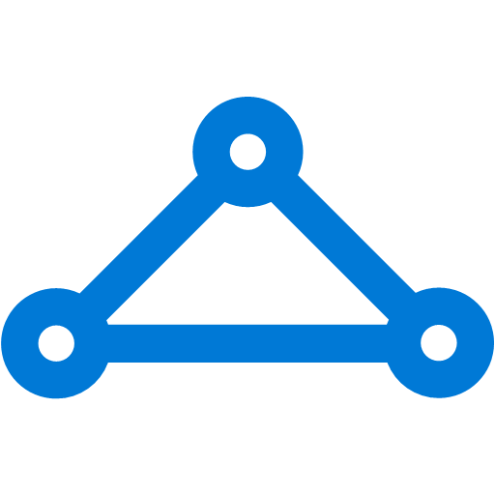




Azure Virtual WAN – Unified Cloud Connectivity
GA
Features
VNet
Hubs in Azure
Enable/disable branch to branch
IPsec IKEv1 and IKEv2
Scale unit-based billing
E2E Monitoring and Resource Health
ExpressRoute (Preview)
P2S with IKEv2 and OpenVPN (Preview)
O365 Policy (Preview)
VNet
Corp HQ
VNet
ExpressRoute
VNet
Datacenter
ExpressRoute
VPN
VPN
VPN
Internet
Region 1
Region 2
Region 3
Internet
Branch
Branch
Branch
Branch
Notes:
For larger offices and DC you may need higher throughput OR locations that don’t have good Internet ExpressRoute is a good option.

Slide 15
Step 2
Execution:
Open a new PowerShell ISE session
Open WorkshopStep2.ps1
(at C:\vdcWorkshop\Scripts)
Run WorkshopStep2.ps1

Slide 16
Step 3
Execution:
Open a new PowerShell ISE session
Open WorkshopStep3.ps1
(at C:\vdcWorkshop\Scripts)
Run WorkshopStep3.ps1

Slide 17




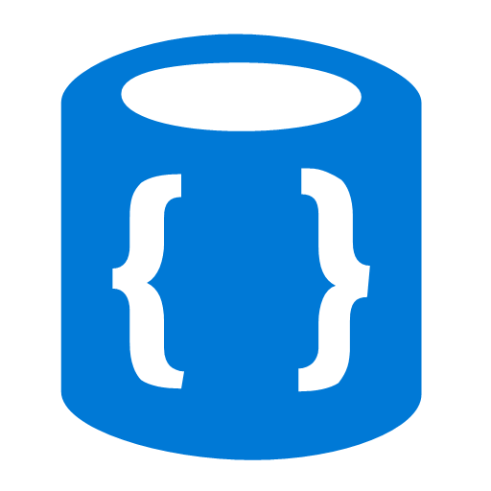




ExpressRoute
✔ Unified connectivity to Microsoft Cloud Services
✔ Predictable performance
✔ Enterprise-grade resiliency and with SLA for availability
✔ Large and growing ExpressRoute partner ecosystem
Customer’s Network
Partner Edge
Primary Connection
Microsoft Edge
Secondary Connection
ExpressRoute Circuit
Microsoft Peering for Office 365, Dynamics 365, Azure public services (public IPs)
Azure Private Peering for Virtual Networks

Slide 18

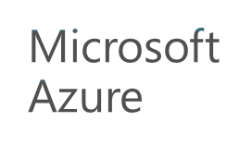

ExpressRoute Direct
Direct – 10 Gbps or 100 Gbps to Azure
Customers given LOA for dual 10/100G connections to ExpressRoute routers
Optimized for massive data ingestion to Azure Storage, Cosmos DB, Azure SQL
Customer demand due to compliance
New 40G, 100G circuits on 100 Gbps ExpressRoute Direct
Fast path – Up to 100Gbps to VNet – no gateway in the data path
Higher single TCP flow throughput
Higher packets per second, connections per second
Lower and more predictable end-to-end latency
Improved reliability
ExpressRoute Direct
ExpressRoute Peering Location
Notes:
Add what is NEW here
FASTEST!!
Logical/virtual circuits on the ExpressRoute Direct port pair
Massive data ingestion or MDI

Slide 19
ExpressRoute Local
ER Site | Local Azure DC
Amsterdam | West Europe
Amsterdam2 | West Europe
Atlanta | (n/a)
Auckland | (n/a)
Busan | Korea South
Canberra | Australia Central
Canberra2 | Australia Central2
Cape Town | South Africa West
Chennai | South India
Chennai2 | South India
Chicago | North Central US
Dallas | (n/a)
Denver | West Central US
Dublin | North Europe
Frankfurt* | (n/a)*
Hong Kong | East Asia
Johannesburg | South Africa North
Kuala Lumpur | (n/a)
Las Vegas | (n/a)
London | UK South
London2 | UK South
Los Angeles | (n/a)
Marseille | France South
Melbourne | Australia Southeast
Miami | (n/a)
Montreal | (n/a)
ER Site | Local Azure DC
Mumbai | West India
Mumbai2 | West India
New York | (n/a)
Newport | UK West
Osaka | Japan West
Paris | France Central
Perth | (n/a)
Quebec City | Canada East
San Antonio | South Central US
Sao Paolo | Brazil South
Seattle | West US 2
Seoul | Korea Central
Silicon Valley | West US
Silicon Valley2 | West US
Singapore | Southeast Asia
Singapore2 | Southeast Asia
Sydney | Australia East
Sydney2 | Australia East
Taipei | (n/a)
Tokyo | Japan East
Tokyo2 | Japan East
Toronto | Canada Central
Washington DC | East US, East US 2
Washington DC2 | East US, East US 2
Zurich* | (n/a)*
Access only Azure regions in the same metro as ER site
No egress data transfer charges
Available on ExpressRoute Direct
Not available at sites far from Azure datacenters
ExpressRoute circuit types
Local: access nearby Azure datacenters
Standard: access Azure regions in same geo
Premium: global
* Local will be available when new Azure regions nearby are live

Slide 20
ExpressRoute Global Reach
US West
UK South
10.0.3.0/24
10.0.4.0/24
ExpressRoute enables you to connect your datacenter to Azure
ExpressRoute Global Reach enables enterprises to connect their sites
On-demand connectivity using existing ExpressRoute circuits
Traffic stays on Microsoft’s global network
Complements service provider’s WAN solution
VNET 1
VNET 2
ExpressRoute Global Reach
Silicon Valley
London
10.0.1.0/24
10.0.2.0/24
San Francisco
London
Notes:
**Build up**
-Using existing infrastructure – connect ER circuits together on-demand
-Uses Microsoft’s global network and global presence
-Emphasize works with WAN provider – multi national – utilize our WAN for sites your provider may not be present

Slide 21
ExpressRoute
Global Reach
Local service provider “XYZ”
Service Provider in the US
ExpressRoute in Tokyo
Supported on Standard and Premium circuits
Extending Azure private peering
Capability for full mesh network
Available in Public Cloud
Australia, Canada, France, Germany, Hong Kong, Ireland, Japan, Korea, Netherlands, Singapore, Switzerland, U.S., and U.K.
Available in US Government Cloud
ExpressRoute in Silicon Valley
Microsoft global network
ExpressRoute in Hong Kong
Local service provider “ABC”
Notes:
Used in geo and outside the geo with a simple flip of SKU – instant access to *global network*
Private access end to end
-Build complex network environments
-Available in a lot of countries – Australia very new
-Also supported in US Gov cloud
----Transition to Demos----

Slide 22
Step 1, 2, and 3 Validation
All resources are now created for the simulated on-prem and vWAN hub.
Take a few minutes in the Azure Portal and validate these resources
Review the HUB:
Azure Portal: https://portal.azure.com, navigate to resource group CompanyXX-Hub01, click into your vWAN CXX-vWAN01
Review the following tabs in the vWAN:
VPN Sites (empty for now but we’ll create some soon)
Hubs (note the VPN Sites value, we’ll add some soon)
Virtual network Connections (no connections, but we’ll add some soon)
SSH to NetFoundry Device (via PowerShell command line window (not ISE!!))
ssh.exe nfadmin@<<Device IP>>
It’s a Linux box so generic Linux commands will work
Type “Exit” to leave the SSH session
SSH to Cisco Device (via PowerShell command line window (not ISE!!))
ssh.exe User01@<<Device IP>> Use the User01 password from Key Vault
It’s a cisco router so you can run commands like “Show Run” to see config
Type “Exit” to leave the SSH session
Once done, close all PowerShell windows

Slide 23
Step 4
Execution:
Open a new PowerShell ISE session
Open WorkshopStep4.ps1
(at C:\vdcWorkshop\Scripts)
Run WorkshopStep4.ps1
Validation:
Browse to your vWAN in the Portal
Look at Virtual Network Connections
You should see two VNets (both Azure sites)
Take Away:
Your Azure VNets are now connected (via VNet peering) to your vWAN Hub

Slide 24
Step 5
Execution:
Open a new PowerShell ISE session
Open WorkshopStep5.ps1
(at C:\vdcWorkshop\Scripts)
Run WorkshopStep5.ps1
Follow activation steps output from script
It will take 10 – 15 minutes for the NetFoundry appliance to register with the NetFoundry service and for the tunnel to come up.
Proceed to Step 5 and we’ll validate this step together with Step 6.

Slide 25
Step 6
Execution:
Open a new PowerShell ISE session
Open WorkshopStep6.ps1
(at C:\vdcWorkshop\Scripts)
Run WorkshopStep6.ps1
Follow activation steps output from script
You’ll need to generate the Cisco VPN config after you log in to the router.
This config is generated by running the Get-CiscoConfig.ps1 in another PowerShell window.
It will take about 2 minutes for the tunnel to come up after completing the router config.

Slide 26
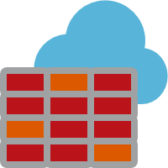
Azure Firewall
Cloud native stateful Firewall as a service
A first among public cloud providers
L3-L7 Connectivity Policies
Spoke 1
NAT, Network and Application traffic filtering rules allows Inbound/Outbound access
Central governance of all traffic flows
Built-in high availability and auto scale
Network and application traffic filtering
Centralized policy across VNets and subscriptions
Complete VNET protection
Filter Outbound, Inbound, Spoke-Spoke & Hybrid Connections traffic (VPN and ExpressRoute)
Centralized logging
Archive logs to a storage account, stream events to your Event Hub, or send them to Log Analytics or Security Integration and Event Management (SIEM) system of choice
Central VNet
Spoke2
Azure Firewall
Spoke VNets
Azure to On-Prem traffic filtering
Traffic is denied by default
On-Premises
Notes:
Easily configure connectivity policies for all your resources using network & application (fully qualified domain name filtering) rules
Both inbound and outbound support and NAT (SNAT and DNAT)
FQDN Tags support (e.g. Windows Update, ASE) to allow easy rule creation
Deployed in a click; fully integrated with the Azure Platform

Slide 27
Step 5 and 6 Validation
10.17.xx.4
10.17.xx.36
Validation:
Browse to your vWAN in the Portal
Look at VPN Sites
You should see two Sites (01 and 02)
The Sites should be associated with your hub
The Sites statuses should be “All connected”
From the Site01 VM, try pinging the VM in Azure 01, 10.17.xx.4
From the Site01 VM, try pinging the VM in Site 02, 10.17.xx.164
Take Aways:
Your two “on-prem” sites are now connected to your Azure Virtual WAN. This gives you connectivity to the two Azure Sites and between your two on-premises Sites via the vWAN Hub.
10.17.xx.132
10.17.xx.164

Slide 28
Step 7

Slide 29
Step 8

Slide 30
Final

Slide 31
Other Networking Sessions This Week

